Slide 1
Ecommerce
Avinash Maskey

Slide 2

What is Commerce?
According to Dictionary.com,
Commerce is a division of trade or production which deals with the exchange of goods and services from producer to final consumer.
It comprises the trading of something of economic value such as goods, services, information, or money between two or more entities.

Slide 3
What is E-Commerce?
Commonly known as Electronic Marketing.
“It consist of buying and selling goods and services over an electronic systems Such as the internet and other computer networks.”
“E-commerce is the purchasing, selling and exchanging goods and services over computer networks (internet) through which transaction or terms of sale are performed Electronically.

Slide 4
Brief History Of E-Commerce
1970s: Electronic Funds Transfer (EFT)
Used by the banking industry to exchange account information over secured networks
Late 1970s and early 1980s: Electronic Data Interchange (EDI) for e-commerce within companies
Used by businesses to transmit data from one business to another

Slide 5
Brief History Of E-Commerce
1990s: the World Wide Web on the Internet provides easy-to-use technology for information publishing and dissemination
Cheaper to do business (economies of scale)
Enable diverse business activities (economies of scope)
1995-1999: witnessed many innovative applications ranging from advertisement to auctions and virtual reality experiences.
Almost every medium- and large-sized organization in the United States already has a Web site many are very extensive.

Slide 6
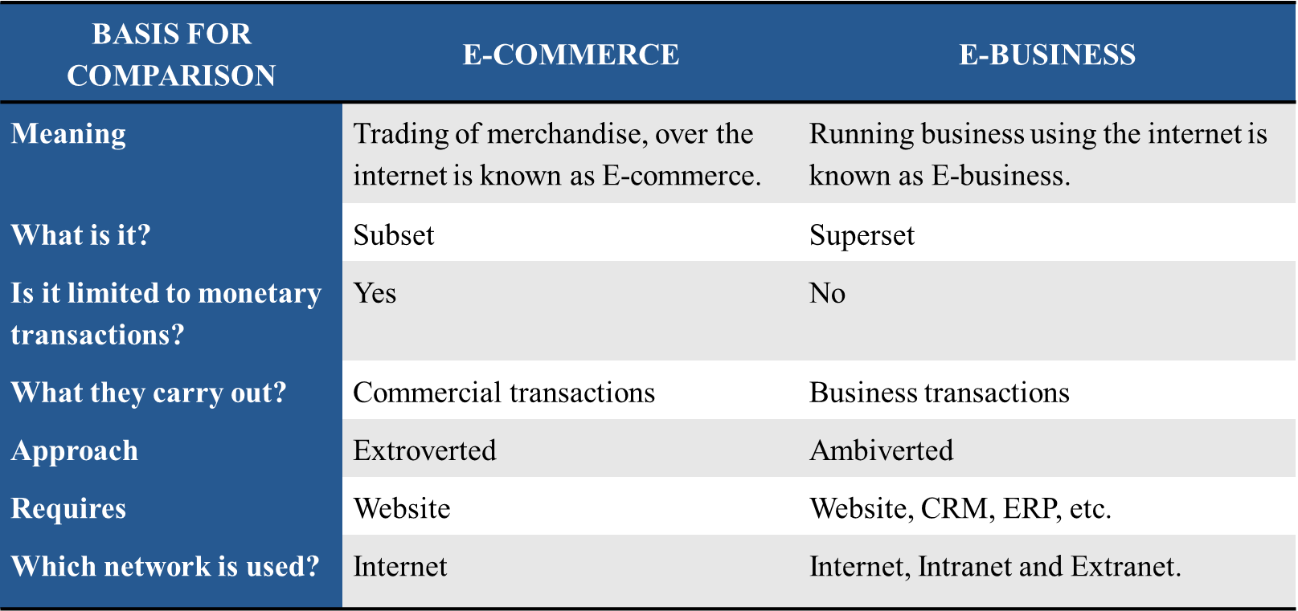
Difference Between e-commerce and e-business

Slide 7
Electronic Commerce under different perspectives:
Let’s see how Electronic Commerce (EC) is defined under each perspective:
1. Communications Perspective
EC is the delivery of information, products /services, or payments over the telephone lines, computer networks or any other electronic means.
2. Business Process Perspective
EC is the application of technology toward the automation of business transactions and work flow.

Slide 8
Electronic Commerce under different perspectives:
3. Service Perspective
EC is a tool that addresses the desire of firms, consumers, and management to cut service costs while improving the quality of goods and increasing the speed of service delivery.
4. Online Perspective
EC provides the capability of buying and selling products and information on the internet and other online services.

Slide 9
Types of E-Commerce
If you’re starting an ecommerce business, odds are you’ll fall into at least one of these four general categories.
Types of Ecommerce are:
B2C – Business to consumer
B2B – Business to business
C2B – Consumer to business
C2C – Consumer to consumer

Slide 10
Types of E-Commerce
B2C – Business to consumer:
B2C businesses sell to their end-user. The B2C model is the most common business model, so there are many unique approaches under this umbrella.
Anything you buy in an online store as a consumer- think wardrobe, household supplies, entertainment is done as part of a B2C transaction.
The decision-making process for a B2C purchase is much shorter than a business-to- business (B2B) purchase, especially for items that have a lower value.
Examples: Daraz, Sastodeal, Gyapu, Foodmandu, MetroTarkari etc.

Slide 11
Types of E-Commerce
B2B – Business to business:
In a B2B business model, a business sells its product or service to another business. Sometimes the buyer is the end user, but often the buyer resells to the consumer.
B2B transactions generally have a longer sales cycle, but higher order value and more recurring purchases.
Examples: Business Software (e.g., HR, ERP, Content Marketing Software) and Business Supplies (e.g., Alibaba)

Slide 12
Types of E-Commerce
C2B – Consumer to business:
C2B businesses allow individuals to sell goods and services to companies.
In this ecommerce model, a site might allow customers to post the work they want to be completed and have businesses bid for the opportunity. Affiliate marketing services would also be considered C2B.
Elance (now Upwork) was an early innovator in this model by helping businesses hire freelancers.
Examples: Upwork, Fiverr, PeoplePerHour etc.

Slide 13
Types of E-Commerce
C2C – Consumer to consumer:
A C2C business - also called an online marketplace - connects consumers to exchange goods and services and typically make their money by charging transaction or listing fees.
C2C businesses benefit from self-propelled growth by motivated buyers and sellers, but face a key challenge in quality control and technology maintenance.
Examples: Hamrobazar (Nepal), eBay (India), Facebook Marketplace etc.

Slide 14
Classifications of E-Commerce Applications
Electronic Commerce (e-Commerce) is a general concept covering any form of business transaction or information exchange executed using Information and Communication Technologies (ICTs).
E-Commerce takes place between companies, between companies and their customers, or between companies and public administrations. Electronic Commerce includes electronic trading of goods, services and electronic material.
E-Commerce systems include commercial transactions on the Internet but their scope is much wider than this; they can be classified by application type:

Slide 15
Classifications of E-Commerce Applications
Electronic Markets:
The principal function of an electronic market is to facilitate the search for the required product or service. Airline booking systems are an example of an electronic market.
Internet Commerce:
The Internet (and similar network facilities) can be used for advertising goods and services and transacting one-off deals. Internet commerce has application for both business to- business and business to consumer transactions.

Slide 16
Classifications of E-Commerce Applications
Electronic Data Interchange (EDI):
Electronic Data Interchange (EDI) is the electronic exchange of business documents in a standard, computer processable, universally accepted format between-trading partners.
EDI is quite different from sending electronic mail, messages or sharing files through a network. In EDI, the computer application of both the sender and the receiver, referred to as Trading Partners (TPs) have to agree upon the format of the business document which is sent as a data file over electronic messaging service.

Slide 17
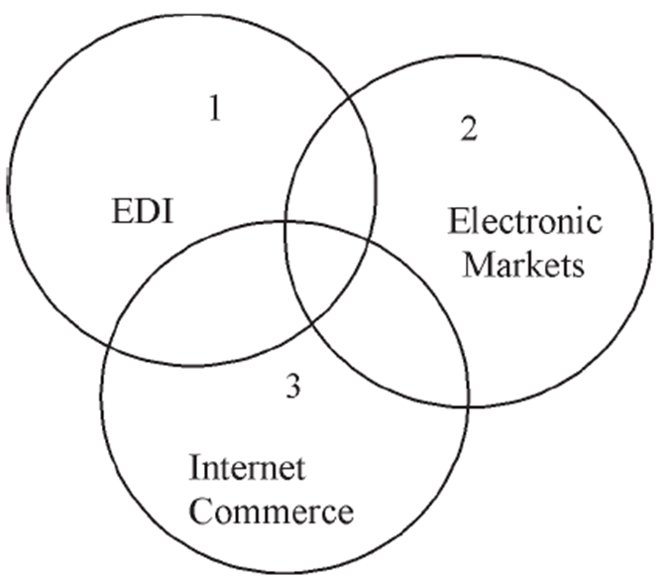
Classifications of E-Commerce Applications

Slide 18
The benefits of E-commerce
The global/local marketplace
24/7 trading
Start-up and running costs
Search facilities
Pricing opportunities (mainly Fluid Pricing)
Gathering customer information
Alternative income sources

Slide 19
Pros For Consumer
Lower prices
Wider selection of product
Products are easy to find in categories and easy to be compared
International customer access
No inventory needed
Shop in the comfort of your own home
24/7 business hours

Slide 20
Cons for Consumer
Cannot feel, touch, or try on items.
Shipping Costs
Required credit card for security purposes
Distribution of private information. (Name, Address, etc.)

Slide 21
Cons for Consumer
Cannot feel, touch, or try on items.
Shipping Costs
Required credit card for security purposes
Distribution of private information. (Name, Address, etc.)

Slide 22
The drawbacks of E-Commerce
Although e-commerce is a tremendous opportunity for businesses, there are also downsides which need to be explored:
Lack of human contact
Delivery issues
International legislation (e.g., liquor)
Product description problems
Security issues

Slide 23
Risks Associated with E-Commerce
Credit Card Theft
Damaged Brand
Interruption of business

Slide 24
History of E-Commerce business in Nepal?
Online shopping in Nepal dates back to 2000 with the launch of Muncha and Thamel Dot Com the same year. Thamel dot com used to sell Khasi (goats) online during Dashain. Nepalis living abroad would order Khasi for their family back home and make payment (remit the money). After receiving the money, Thamel dot com would deliver the Khasi to the doorstep of their family. Although this was limited to just Kathmandu Valley, this marked an start of ecommerce business in Nepal.

Slide 25
Challenges of E-Commerce business in Nepal
Nepalese have a lot of free time in Hand. They can walk to the store and buy things anytime. This is one of the major challenges of the eCommerce business.
Shopping is a group activity most of the time. Whenever one has to buy something, he/she goes to the shop with a bunch of friends. This experience is also another challenge for eCommerce sites.
Delivery is another huge challenge.
Technology and literacy of Technology.

Slide 26
Challenges of E-Commerce business in Nepal
People are using eCommerce platforms merely to check the prices so that they can bargain while buying the product from an offline vendor. So, they are used more as a reference tool than a buying platform.
Lack of credit card and wallet system. However, this challenge is being reduced due to many e-wallet providers such as esewa, khalti and imepay. Also, banks are attempting to increase the use of credit cards.
The global problem; missing the touch and feel of products you are buying. This problem acts as a challenge in Nepal as well.
Lack of proper street maps is also another major challenge for delivery.

